Slide 1
Math 321 Differential Equations
Final Class!
Quick overview of differential equations
View on Moodle
  Final Survey.
  IDEA Course Evaluation
  Final Exam
Questions and Answers

Slide 2
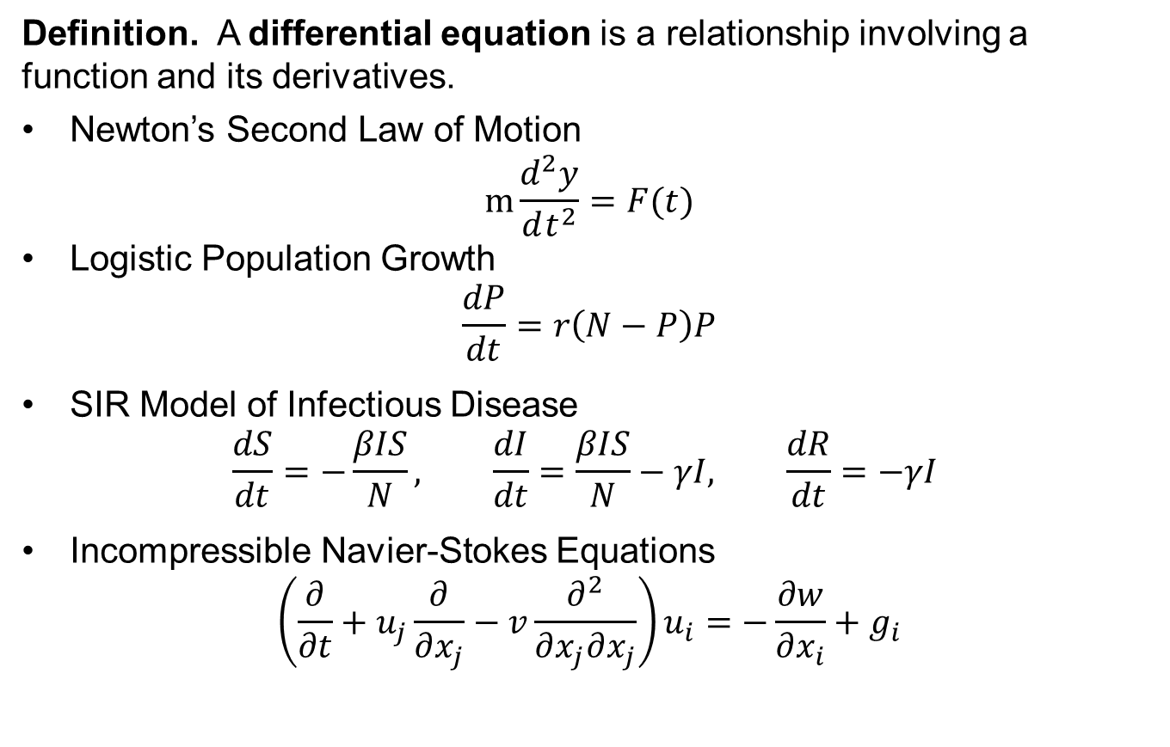
Differential Equations
Definition. A differential equation is a relationship involving a function and its derivatives.
Newton’s Second Law of Motion
$m\frac{d^{2}y}{dt^{2}}=F(t)$
Logistic Population Growth
$\frac{dP}{dt}=r\left(N−P\right)P$
SIR Model of Infectious Disease
$\frac{dS}{dt}=−\frac{βIS}{N}, \frac{dI}{dt}=\frac{βIS}{N}−γI, \frac{dR}{dt}=−γI$
Incompressible Navier-Stokes Equations
$\left(\frac{∂}{∂t}+u_{j}\frac{∂}{∂x_{j}}−v\frac{∂^{2}}{∂x_{j}∂x_{j}}\right)u_{i}=−\frac{∂w}{∂x_{i}}+g_{i}$

Slide 3
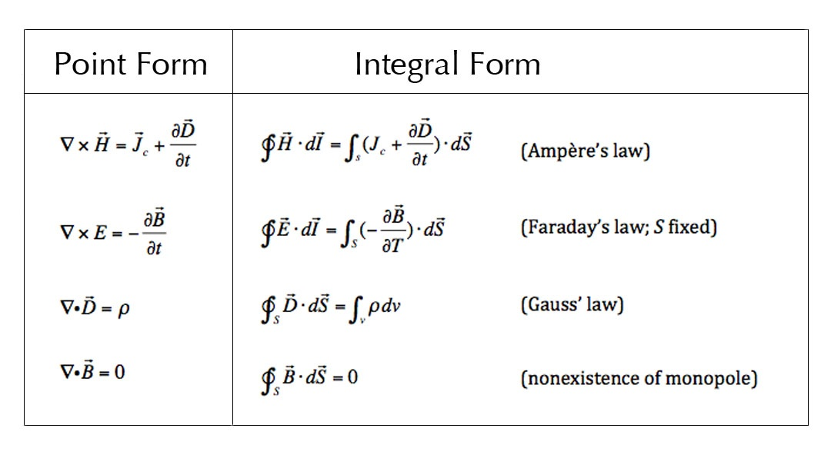
Differential Equations
And God said …
… and there was light.

Slide 4
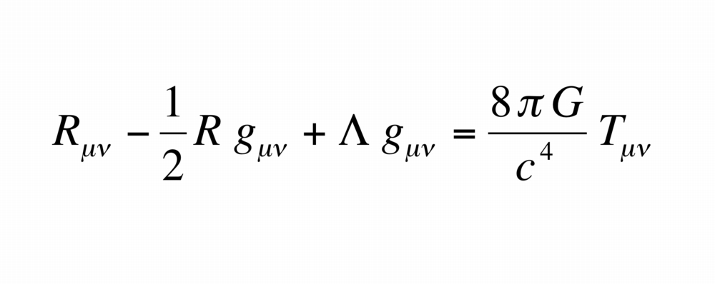
Differential Equations
And God said …
… and there was gravity.

